Slide 1
Binary Trees
Dr. Ron Eaglin

Slide 2
The Node
Parent
ID
Content
Right
Left

Slide 3
Binary Tree
Top
Branch
Leaf

Slide 4
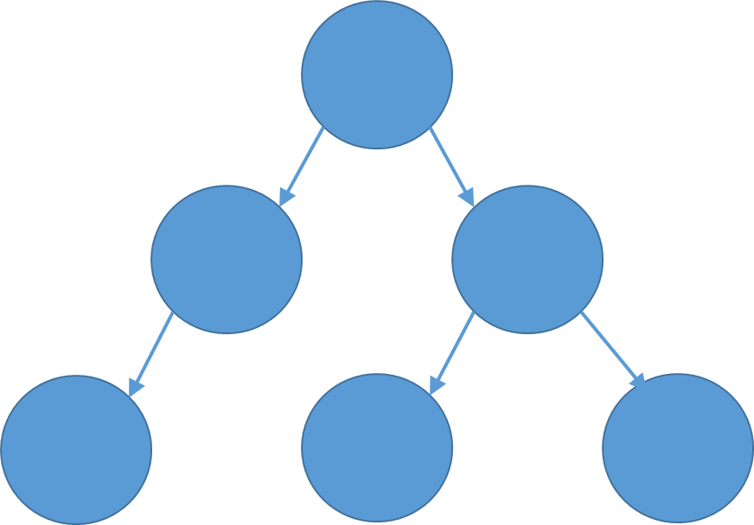
Left-Most Traversal
A
B
C
D
E
F
A – B – D - B – A – C – E – C - F

Slide 5
Types of Tree – AVL Tree
Heights of the subtrees never differs by more than one

Slide 6
Tree Types - Heap
The tree is complete (or near complete) – one level is completed before the next level starts
Value of parent always greater than value of descendants
100
19
36
3
25
11

Slide 7
Tree Types – TRIE / Radix tree
More than two descendants per node
Useful for systems like spell-check systems (top node – 26 children)

