Slide 1


COP3530- Data Structures
Arrays and Lists
Dr. Ron Eaglin

Slide 2
Objectives
Learn to use Arrays in programming (JavaScript)
Understand properties of arrays and lists
Understand limitations of arrays and lists
create a List in JavaScript code

Slide 3
Properties of an Array
Integer index of elements within an array
var array = [‘element 1’, ‘element 2’, ‘element 3’];
Array[0] will be ‘element 1’ (normally indexed at 0)
Random access

Slide 4
Accessing Array Elements
0 1 2 3 4 5 6 7 8 9
If each element has size z – address of element is i*z
Arrays are typically held in memory sequentially
Gives high level of efficiency, but has limitations (memory)

Slide 5
Arrays in JavaScript - Declaring
var a = [];
var a = [‘a’, ‘b’, ‘c’, ‘d’];
var a = new Array();
var a = new Array(‘1’, ‘2’, ‘3’, ‘4’);

Slide 6
Arrays as Objects
Arrays are objects
Limitation: Arrays use numbers to access elements (Objects in general use names)

Slide 7
Array Properties and Methods (JavaScript)
Array.length – returns length of array
Array.push() – pushes element onto end of array
Array.pop() – Removes last element of array (returns element)
Array.sort() – sorts the array
Array.splice() – Adds/removes elements from array
Array.concat() – Concatenates two or more arrays
Array.find() – Returns first element of array meeting condition
More methods

Slide 8
List (Abstract Data Type)
Represents an ordered sequence of values
Head
Head

Slide 9
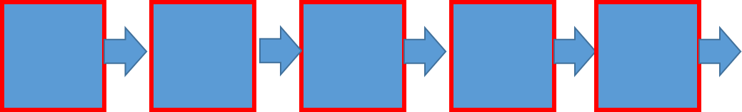
List (implementation)
Singly Linked List
var List = new function() {
this.head = null;
}

Slide 10
Node (Singly Linked Node)
Can be designed per need of node (List)
var Node = function() {
this.ID = null;
this.content = null;
this.next = null;
}
Content
ID
Next

Slide 11
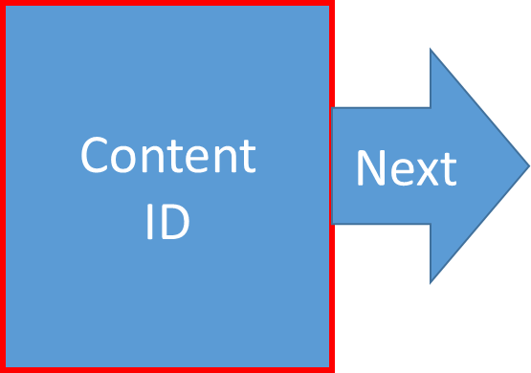
Node (Doubly Linked List)
var Node = function() {
this.ID = null;
this.content = null;
this.next = null;
this.last = null;
}
Last

Slide 12
List and Node Properties
Created to meet the needs of the application
Basic Methods of a List
  New – Constructor to create a List
  Add – Add nodes to a List
  isEmpty() – Determine if an Array is completely empty
  Head or Head() – Answers the element at the head
  Tail or Tail() – Answers the node at the tail

Slide 13
Why Lists?
Lists are stored in dynamic memory
Adding elements to List is easier (do not require sequential memory)
Lists are used to implement Stacks and Queues
Lists are the fundamental Abstract Data Type

Slide 14
Creating a List (in JavaScript)
Define List Class
var List = new function() {
this.head = null;
this.length = 0;
this.tail = null;
}

Slide 15
Creating a List
Define Node Class
var Node = new function(_content) {
this.next = null;
this.content = _content;
}

Slide 16
Creating a List
Define Add method
function add(aNode) {
if tail is null -> head = aNode; tail = aNode; length = 1
if head == tail -> head.next = aNode, tail = aNode; length++
if tail is not null -> tail.next = aNode; length++
}

Slide 17
Define other needed functions
Delete
Dealing with Content
Sorting on Add
Insert

Slide 18
Objectives
Learn to use Arrays in programming (JavaScript)
Understand properties of arrays and lists
Understand limitations of arrays and lists
create a List in JavaScript code

