Slide 1


COP3530- Data Structures
B Trees
Dr. Ron Eaglin

Slide 2
Objectives
Describe the properties of multi-way trees
Describe structure and purpose of B-Trees
Describe structures and purpose of B+Trees
Describe structure and use of a TRIE

Slide 3
B- Trees
Designed to minimize access time for reading/writing large blocks of data
Internal nodes can have a variable (but constrained) number of child nodes
All leaf nodes must be at the same height (depth).
The size of each node can be the same as the size of a block (memory access)

Slide 4
Definition of B-Tree (order m)
The root has at least 2 subtrees unless it is a leaf
Each nonroot and nonleaf node holds k-1 keys and k references to subtrees (m/2 <= k <= m, or k is between m/2 and m)
Each leaf node holds k-1 keys (k is between m/2 and m)
All leaves are on the same level.

Slide 5
B-tree (order 5)
50 | | |
10 | 15 | 20 |
70 | 80 | |
6 | 7 | |
11 | 12 | |
21 | 25 | 27 | 29
54 | 56 | |
71 | 76 | |
81 | 87 | |

Slide 6
Key Insertion
Challenge: All leaves MUST be at the same level
If leaf is not full – simply insert in leaf
If leaf is full, split leaf; move last key of new leaf to the parent.
If root is full, split root – apply algorithm to balance

Slide 7
Key Deletion
Key deletion also requires balancing and use of rules of the B-Tree
Psuedocode for node insertion and deletion in B trees is available on Wikipedia and other sites

Slide 8
Variations (B*-tree)
Issue with B-tree is tree is often only sparsely filled.
Average utilization of space in a B-tree is 69% (assuming random input when filling out tree)
Variant: B*-tree
In a B*-tree all nodes are required to be 2/3 full (except root) which increases average utilization to 81%

Slide 9
Variations (B+-Tree)
Sequential access can be made faster by
  Providing an index to the parent in the leaf nodes
  Sequentially linking leaf nodes as a linked list

Slide 10
B+-tree
30 | | |
5 | 10 | 21 |
1 | 3 | 4 |
5 | 7 | 9 |
10 | 13 | 19 |
21 | 27 | 28 |

Slide 11
Other Tree Structures
R-Tree – very useful for spatial data
2-4 Tree – symmetric binary B-Tree
TRIE – Useful for spell check systems

Slide 12
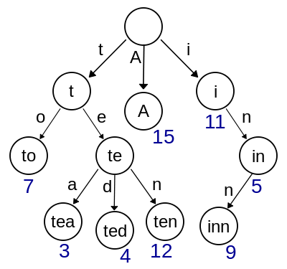
TRIE (Radix or Prefix Tree)
From Wikipedia

Slide 13
Objectives
Describe the properties of multi-way trees
Describe structure and purpose of B-Trees
Describe structures and purpose of B+Trees
Describe structure and use of a TRIE

