Slide 1


COP3530- Data Structures
Balancing Trees
Dr. Ron Eaglin

Slide 2
Objectives
Describe a balanced tree
Implement algorithms to balance trees
Describe advantages of balanced trees
Describe performance issues balancing trees

Slide 3
Balanced Trees
A binary tree is balanced (or height balanced) if
  The difference in height of any subtree (or node) is 0 or 1.
The tree is perfectly balanced if
  It is balanced
  All leaves are found on one or two levels

Slide 4
Why Balanced
Improves searching efficiency
A
G
G
vs.
A
L
D
K
D
K
P
L
P

Slide 5
Balancing Trees – DSW Algorithm
Completes in O(n)
Algorithm Steps
  1. Any arbitrary binary tree is turned into a linked list
  2. A series of left-rotations converts list to a tree
Does not require additional space to execute

Slide 6
DSW Functions – RotateRight
GR
RotateRight(grandParent, parent, leftChild)
  Step 1 - grandparent.right = leftChild
  Step 2 – parent.left = leftChild.right
Par
Ch
Z
X
Y

Slide 7
DSW Algorithm – RotateRight
GR
Step 3 - leftChild.right = parent
Ch
GR
X
Par
Ch
Par
Z
Y
Z
Y
X
After Rotation

Slide 8
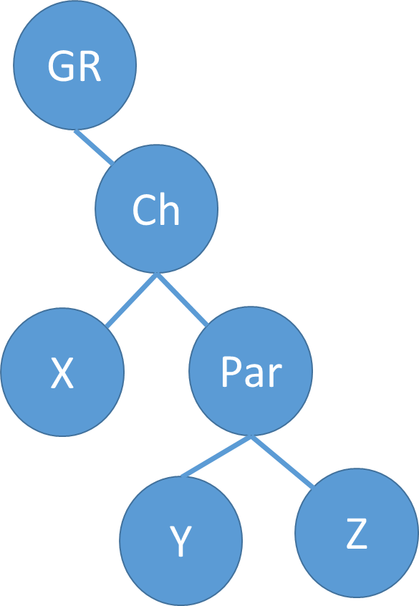
DSW Algorithm
To create the backbone
  If a node has a left child – rotate the child around the node
  (this means the left child becomes the parent of the node)
  Move on to the child (which just became the parent)
  Repeat process
  If there is no left child – just move to the right child and ask again

Slide 9
DSW Algorithm
This process will create a linked list from the previous tree
The linked list will be using left pointer as the node.next.
Next we have to convert back to a balanced tree.

Slide 10
DSW Algorithm
Calculate the greatest power of 2 less than number of nodes (x)
m = x -1, n = number of nodes
Call algorithm – makeRotations(n – m)

Slide 11
DSW - MakeRotations
for (bound = n-m; bound > 0; bound --) {
rotateLeft(grandparent, parent, child)
grandparent = child;
parent = grandparent.right;
child = parent.right;
}
This will rotate back to a balanced tree – rotateLeft is a mirror of rotateRight.

Slide 12
AVL Tree
Self balancing binary search tree
Definition is the same as a balanced tree
AVL tree also includes the algorithm to maintain balance
If the heights of two child subtrees differ by more than one, the tree is rebalanced.

Slide 13
AVL Rotation
A
B
B
A

Slide 14
AVL Rotation – Order is maintained
5
X
8
< X
> X
1
8
5
9
7
9
1
7

Slide 15
AVL Tree
Must be able to handle operations
  Insertion of Node
  Deletion of Node
Algorithm for insertion – rebalance
Algorithm for deletion - rebalance

Slide 16
Heap – type of binary tree
The value stored in each node is not less than the value in each of the children.
The tree is perfectly balanced
The leaves in the last level are all in the leftmost position

Slide 17
Use of Heap
Implement a Priority Queue
  In a priority queue, elements with a high priority are served before elements with a low priority.
Uses
  Prioritizing network traffic (rather than a queue)
  Simulation – certain events must have priority
  Best-first searching – give priority to some search results

Slide 18
Performance
Searching is highly efficient O(logn)
Effort is needed for balancing – performance hit
Balancing can be done at low traffic times

Slide 19
Objectives
Describe a balanced tree
Implement algorithms to balance trees
Describe advantages of balanced trees
Describe performance issues balancing trees

