Slide 1


COP3530- Data Structures
Javascript
Dr. Ron Eaglin

Slide 2
Objectives
Understand the Document Object Model (DOM) and how it works with JavaScript
Know how to get input from the DOM in JavaScript
Understand how to present output to the DOM
Write functions in JavaScript
Execute JavaScript functions from the DOM
Create objects in JavaScript
Extend objects in JavaScript

Slide 3
Overview
JavaScript allows for the manipulation of HTML documents (among other things)
HTML documents follow the Document Object Model (DOM)
All elements in an HTML document can be accessed and manipulated
The access to these elements (objects) is through the DOM

Slide 4
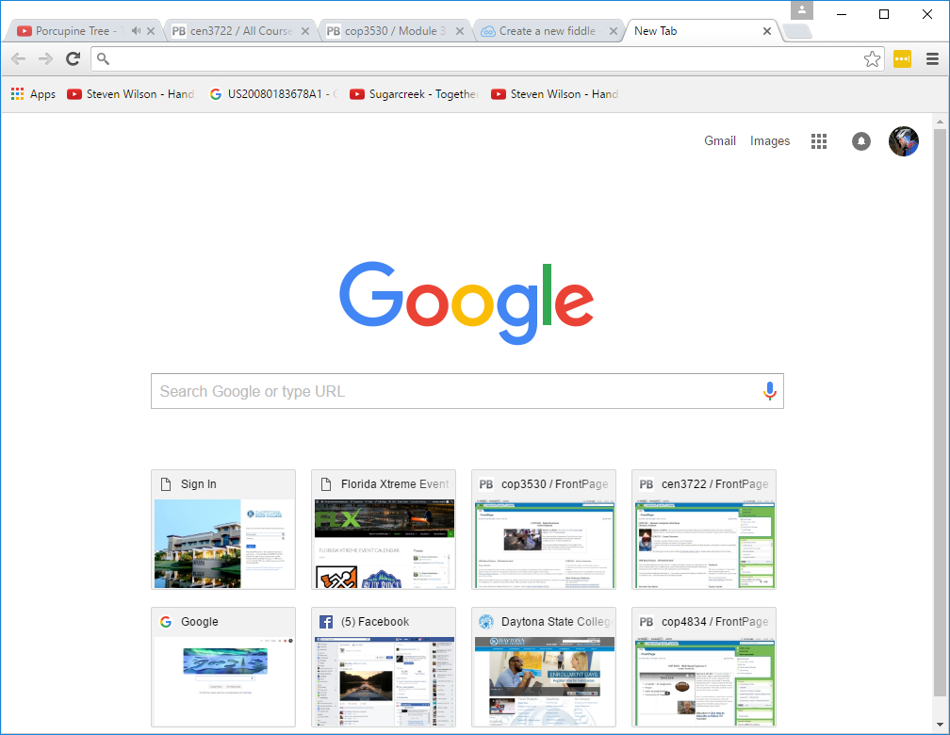
Document Object Model
This is the Document

Slide 5
Accessing the Document
Contents of the document are added as html code (there are other methods)
<input type=‘button’ id=‘myButton’ value=‘A Button’ />

Slide 6
Accessing the Document
In JavaScript the element can be accessed in code
var aButton = document.getElementById(‘myButton’);
document is the Document object (global scope)
getElementById is a function supported by the Document
aButton is the object created in JavaScript.

Slide 7
Events
<input type=‘button’
id=‘myButton’
value=‘A Button’
onclick=‘changeValue()’/>
onclick is a supported event in the DOM
changeValue() is a JavaScript function

Slide 8
Writing a JavaScript function
function changeValue() {
var aButton = document.getElementById('myButton');
aButton.value = "Changed Button Value";
}

Slide 9
Some Review
HTML – language for web pages
DOM – Document Object Model – the “page” is referred to as the global object document and is accessible in JavaScript
Objects can be added to the document (using html)
These objects can be accessed in code document.getElementById()
You can write functions using JavaScript to perform tasks
You can trigger the execution of these objects using events - onclick

Slide 10
Creating an Object
Everything in JavaScript is an object
In JavaScript a function is an object
We can create objects using this
var anObject = function() {
this.anInteger = 0;
this.aString = "Hi";
}

Slide 11
Creating an Object
var MyObject = function() {
this.anInteger = 0;
this.aString = "Hi";
}
This defines the object and the properties of the object – it does not create an instance of the object. This is simply a definition.

Slide 12
Creating an Object
function changeValue() {
var aButton = document.getElementById('myButton');
var anObject = new MyObject();
alert(anObject.anInteger);
aButton.value = anObject.aString;
}
var anObject = new MyObject(); <- This makes an object

Slide 13
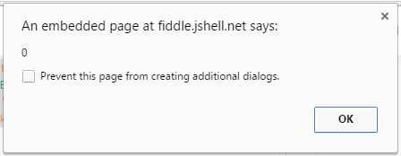
Creating Object
alert(anObject.anInteger);

Slide 14
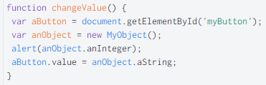
Using Objects

Slide 15
Extending Objects - prototype
  MyObject.prototype.aFunction = function(anArg) {
  return "Prototype Function with Argument " + anArg;
  }
  function changeValue() {
  var aButton = document.getElementById('myButton');
  var anObject = new MyObject();
  aButton.value = anObject.aFunction("Sample Argument");
  }

Slide 16
Extending Objects

Slide 17
Review
  In JavaScript – everything is an Object
  You can create objects simply by defining a function and assigning it a name
  You can extend that object using the prototype keyword.
  You MUST instantiate objects to use them.

Slide 18
JavaScript Output
  <div id="output"> </div> (or use paragraph) <p id=“output> </p>
  function changeValue() {
  var aDiv = document.getElementById('output');
  var anObject = new MyObject();
  aDiv.innerHTML = anObject.aFunction("Sample Argument");
  }

Slide 19

Output to Document

Slide 20
Other Properties
  function changeValue() {
  var aDiv = document.getElementById('output');
  var anObject = new MyObject();
  aDiv.innerHTML = anObject.aFunction("Sample Argument");
  aDiv.style="color:blue; background-color: yellow;";
  }

Slide 21
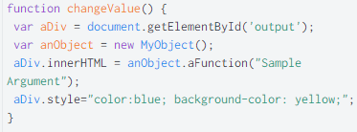
Results Changing Properties

Slide 22
Objectives
Understand the Document Object Model (DOM) and how it works with JavaScript
Know how to get input from the DOM in JavaScript
Understand how to present output to the DOM
Write functions in JavaScript
Execute JavaScript functions from the DOM
Create objects in JavaScript
Extend objects in JavaScript

