Slide 1
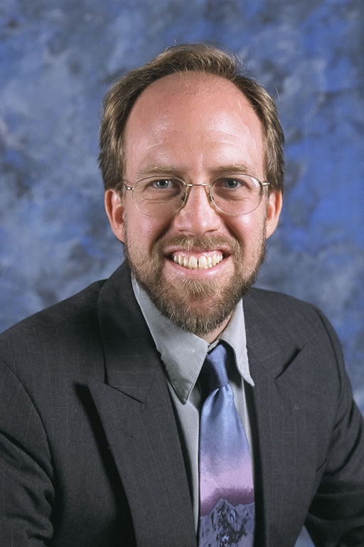
COP3530- Data Structures Recursion
Dr. Ron Eaglin

Slide 2
Objectives
Define Recursion, Recursive Definitions, Anchor, and Ground Case
Interpret equations using recursion
Write recursive functions
Define iterative solutions and identify equivalent iterative and recursive solutions.

Slide 3
Recursive definitions
A recursive definition is a definition that uses itself in the definition
This should seem a violation of defining something
In Mathematics and Computer Science recursive definitions can exist and be unique.

Slide 4
Mathematical Recursive Definition
The definition of the function is included in the definition

Slide 5
Factorial Recursion
6! = 6 * 5 * 4 * 3 * 2 * 1
6! = 6 * 5! 5! = 4 * 3 * 2 * 1
6! = 6 * (6-1)!
Yes it can make sense.

Slide 6
Factorial in Code
function factorial(n) {
if (n == 0) return 1;
return n* factorial(n-1);
}
Note the simplicity of the solution.

Slide 7
Factorial recursive example
function factorial(n) {
if (n == 0) return 1;
return n* factorial(n-1);
}
Anchor or Ground Case

Slide 8
Ground Case / Anchor
If a function calls itself – it must somehow always get out of the call or go on forever.
There always needs to be a ground case/anchor

Slide 9
Use of recursion
Consider f(n) = 2^n
Can be written recursively
| 1, if n = 0
f(n) = |
| 2* f(n-1), if n > 0

Slide 10
Recursion
By looking at the recursive definition of the power equation
Easy to translate into code
function power(base, n) {
if (n == 0) return 1;
return y * power(base, n-1);
}

Slide 11
Tail Recursion
Simplest form of recursive call
Single recursive call made at end of function
Anchor ends call
Power and Factorial (previous examples are tail recursion)

Slide 12
Non-Tail Recursion
Does not have a single recursion call at the end of the function
function Hanoi(n, from, to, via) {
if (n == 0) return;
Hanoi(n-1, from, via, to);
move(from, to);
Hanoi(n-1, via, to, from);
}

Slide 13
Indirect Recursion
F(x) calls G(x)
G(x) calls F(x)
Etc…

Slide 14
Iterative solutions
All recursive functions can also be written without recursion
function factorial(n) {
var result = 1;
for (var i = n; i > 1; i--) {
result = result * i;
}
return result;
}

Slide 15
Objectives
Define Recursion, Recursive Definitions, Anchor, and Ground Case
Interpret equations using recursion
Write recursive functions
Define iterative solutions and identify equivalent iterative and recursive solutions.

