Slide 1


COP3530- Data Structures
Trees Part 2
Dr. Ron Eaglin

Slide 2
Objectives
Describe the Tree and Binary Tree as an Abstract Data Type
Describe different implementations of Binary Trees
Describe uses of the Tree Data Structure

Slide 3
Tree Definition
An empty structure is an empty tree
If t1, …tk are disjoint trees, then the structure whose root has as its its children the roots of t1, … tk is also a tree
Only structures generated by 1 and 2 are trees.

Slide 4
Trees
Empty Tree (height 0)
Tree of height 1
Tree of height 2
All trees shown are binary trees; 0, 1, or 2 leaves
Tree of height 3

Slide 5
Binary trees
A binary tree is a tree whose nodes have two children and each child is designates as either a right child or a left child.
Root
Arc
Node (left child)
Node (right child)

Slide 6
Tree properties
Each node must be reachable from the root through a unique sequence of arcs called a path

Slide 7
Implementing a Binary Tree
var Node = function() {
this.left = null;
this.right = null;
this.content = null;
}
var BinaryTree = function() {
this.root = null;
}

Slide 8
Tree Traversal
Tree traversal is the process of visiting each node in a tree exactly one time.
Breadth-first traversal – visiting each node starting from the lowest level and moving down level by level visiting each node on each level.
Depth-first Traversal – proceeds as far as possible on one side and then backs up.

Slide 9
Tree traversal
15
Breadth-First: 15, 4, 20, 1, 16, 25
Depth-First (LVR): 1, 4, 15, 16, 20, 25
4
20
1
16
25

Slide 10
Depth First – Sample LRV recursive algorithm
Node.traverse()
if (left != null) Node.left.traverse()
if (right != null) Node.right.traverse()
Mark as Visited
L = Left, R = Right, V = Visit denotes order of traversal
LVR and VLR are also 2 possible approaches.

Slide 11
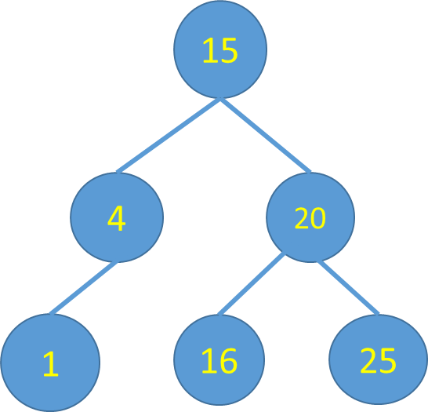
Algorithm Comparison
Depth-First (LVR): 1, 4, 15, 16, 20, 25
Depth-First (LRV): 1, 4, 16, 25, 16, 15
Note: The LVR gives results sorted
and left is always less, right is always more

Slide 12
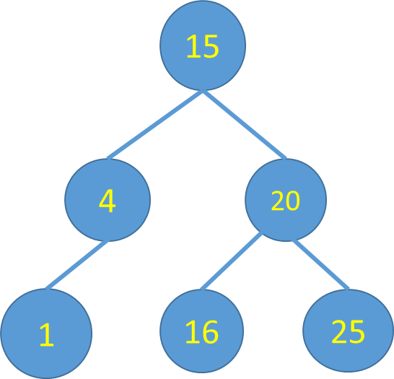
Sorted Trees - Insertion
If New < Current Add Left
If New > Current Add Right
Can create imbalance

Slide 13
Insert – Add a 2 Node
Less than 15
Less that 4
Greater than 2
This algorithm does not balance tree
What if we insert equality?
How do we keep tree balanced?
15
4
20
1
16
25
2

Slide 14
Deletion – Non-trivial Case (20)
Delete 20 from tree
Set DeleteNode.Left to same position as Node
15
4
20
1
16
25
2

Slide 15
Deletion – Non-trivial Case (20)
Delete 20 from tree
Set DeleteNode.Left to same position as Node
15
4
20
16
1
25
2

Slide 16
Use of Binary Trees
Search trees
Binary space partitions – use in 3D video games for determination of rendering priority
Used in routers to store routing table
Databases
Scheduling systems

Slide 17
Objectives
Describe the Tree and Binary Tree as an Abstract Data Type
Describe different implementations of Binary Trees
Describe uses of the Tree Data Structure

