Slide 1
The Hash Function
Dr. Ron Eaglin

Slide 2
What is a hash function?
At its core…
A hash function is any function that can be used to map data of arbitrary size to data of fixed size.

Slide 3
Really?!
A
B
C
D
E

Slide 4
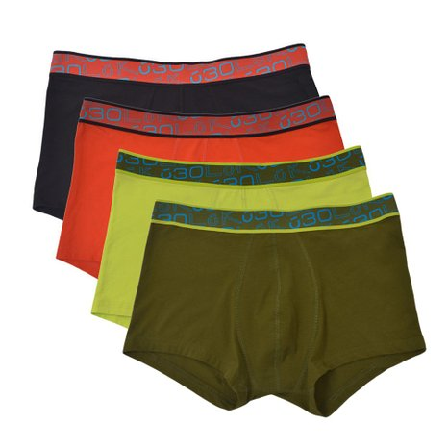
Why would this be important?….

Slide 5
Applications of Hash Functions
Rapid Data Lookup
Hash functions are primarily used in hash tables to quickly locate a data record (e.g., a dictionary definition) given its search key (the headword). Specifically, the hash function is used to map the search key to an index; the index gives the place in the hash table where the corresponding record should be stored.

Slide 6
Applications of Hash Functions
Finding Duplicate Records
Duplicates can then be found by scanning every bucket which contains two or more members, fetching those records, and comparing them. Faster than comparing all records to each other.
Also good for finding similar records….

Slide 7
Applications of Hash Functions
Password Security
Instead of storing passwords in a table – the hashed value is stored instead. The user entered value is hashed and compared against the value stored. The original password is never stored anywhere – more secure.

Slide 8
Applications of Hash Functions
Cryptography
Some standard applications that employ hash functions include authentication, message integrity (using an HMAC (Hashed MAC)), message fingerprinting, data corruption detection, and digital signature efficiency.

Slide 9
Properties of Hash Functions
Deterministic
Same input will always give the same output

Slide 10
Properties of Hash Functions
Uniformity
Maps all inputs evenly over the range of output.

Slide 11
Properties of Hash Functions
Definable Range
The function has a discrete and definable range of outputs.

Slide 12
Properties of Hash Functions
Non-Invertable
Cannot take hashed value and go back to the original key – one way function.

Slide 13
Some Hash Functions
MD5 - https://en.wikipedia.org/wiki/MD5
Zobrist - https://en.wikipedia.org/wiki/Zobrist_hashing
Blake - https://en.wikipedia.org/wiki/BLAKE_(hash_function)
Grøstl - https://en.wikipedia.org/wiki/Gr%C3%B8stl
And many many more….

